Slide 1
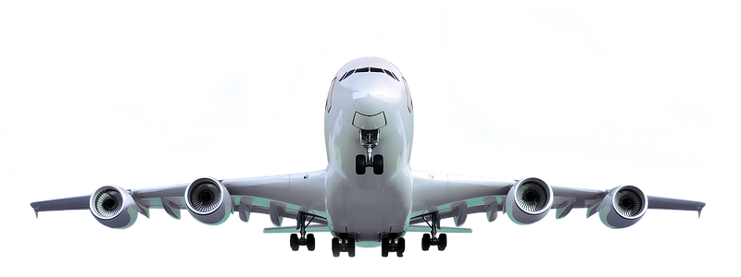

AEROSPACE
ENGINEERING

Slide 2



AEROSPACE
Where It's Used: Aerospace engineering ranges from commercial airplanes to satellites and rockets.
Key Skills:
Aerospace engineers use many skills including aerodynamics, materials science, and propulsion systems
What It Is:
Aerospace engineering focuses on the design, development, and testing of aircraft and spacecraft.

Slide 3
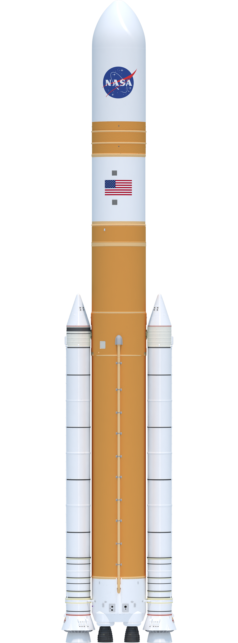
AEROSPACE
What It Is:
Aerospace engineering focuses on the design, development, and testing of aircraft and spacecraft.
Key Skills:
Aerospace engineers use many skills including aerodynamics, materials science, and propulsion systems
Where It's Used: Aerospace engineering ranges from commercial airplanes to satellites and rockets.

Slide 4
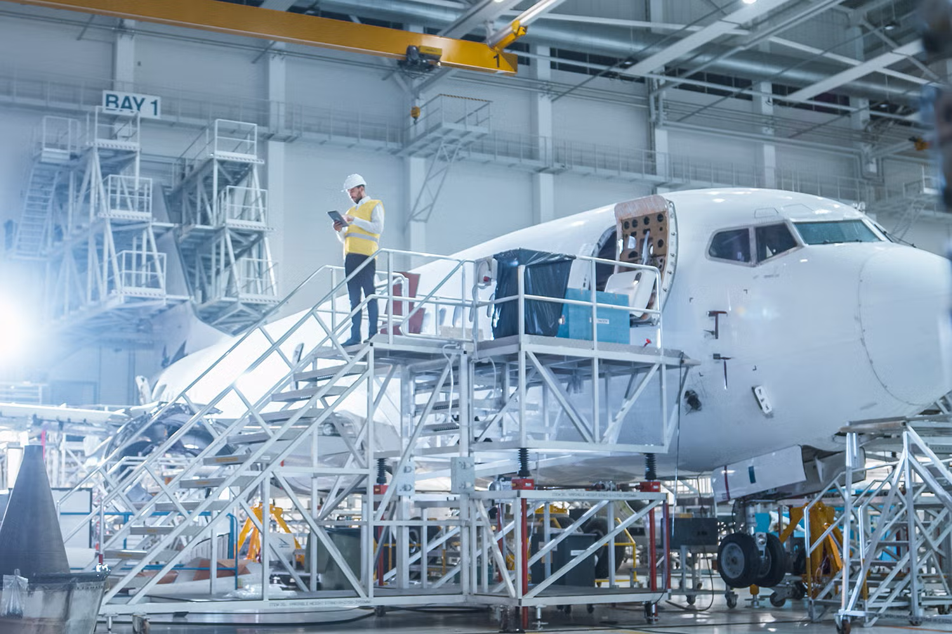
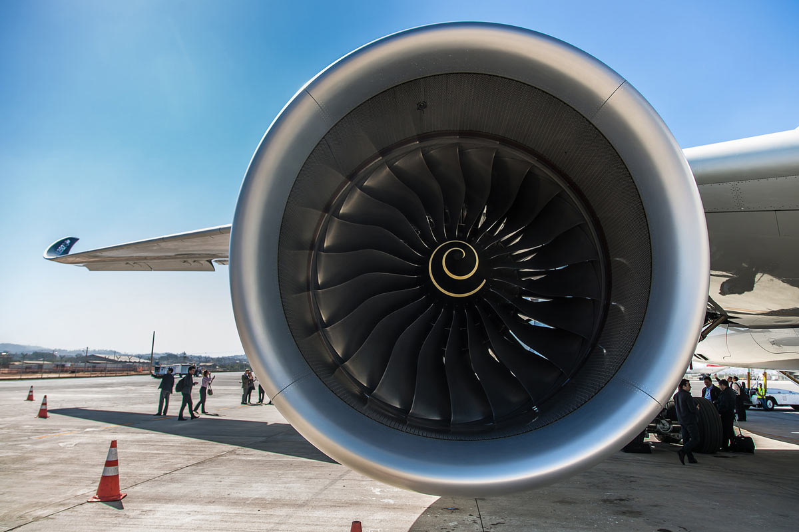
What Do Aerospace
Engineers Do?
Aerospace Engineers:
Aerospace Engineers design and develop aircraft and spacecraft.
This includes commercial airplanes, military jets, satellites, and rockets.
They ensure these vehicles are safe, efficient, and capable of performing their missions.
Aerospace
Engineering Fields
Propulsion Engineers:
Design the engines that provide rockets, missiles, satellites and other spacecraft with the means to move in the air or in space

Slide 5
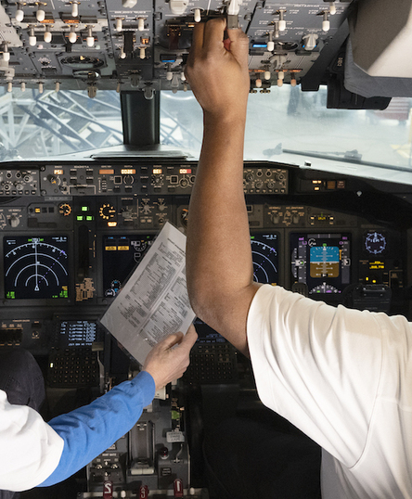
What Do Aerospace
Engineers Do?
Aerospace Engineers:
Aerospace Engineers design and develop aircraft and spacecraft.
This includes commercial airplanes, military jets, satellites, and rockets.
They ensure these vehicles are safe, efficient, and capable of performing their missions.
Aerospace
Engineering Fields
Propulsion Engineers:
Design the engines that provide rockets, missiles, satellites and other spacecraft with the means to move in the air or in space

Slide 6
What Do Aerospace
Engineers Do?
Aerospace Engineers:
Aerospace Engineers design and develop aircraft and spacecraft.
This includes commercial airplanes, military jets, satellites, and rockets.
They ensure these vehicles are safe, efficient, and capable of performing their missions.
Aerospace
Engineering Fields
Avionics Engineers:
Design and maintain the electronic systems in aircraft and spacecraft, such as navigation, communication, and control systems.

Slide 7
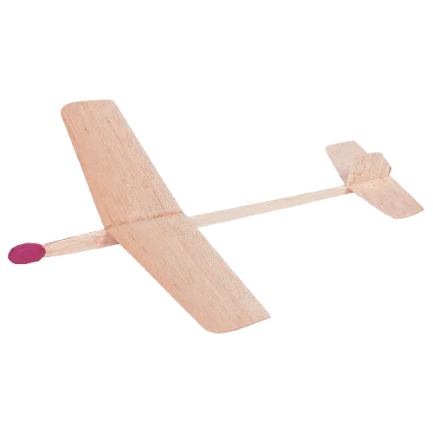
Glider Project
Your goal is to design and construct a glider out of balsa wood, cardstock, and straws.
The challenge is to design the furthest flying plane.
You will have to consider many factors such as: lift, weight, design, etc
Materials:
2 sheets of cardstock paper
1 Penny
3 Straws
1 Balsa stick
Scotch tape

Slide 8
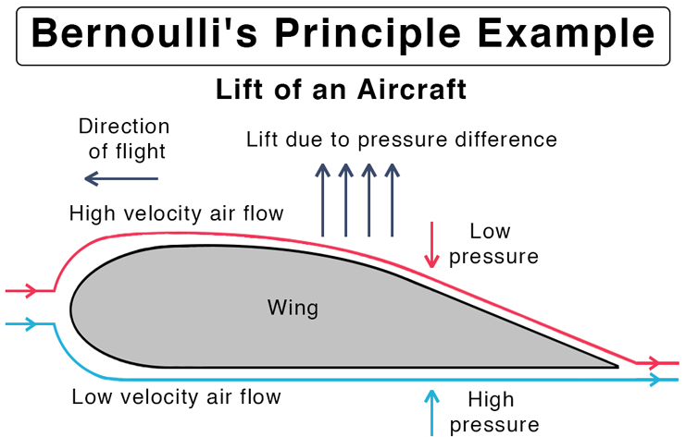
Key Lesson:
Lift
An easy way to make your plane fly farther is to shape the wings in a specific (airfoil) way, but do you know why?
Bernoulli’s Principle:
Air pressure difference: When air moves faster, the pressure is lower. When it moves slower, the pressure is higher.
Wings and air: The shape of a wing (which is called an airfoil) makes air move faster over the top and slower under the bottom.
Lift: The lower pressure on top and higher pressure underneath creates a force that pushes the wing up – this is called lift.

Slide 9
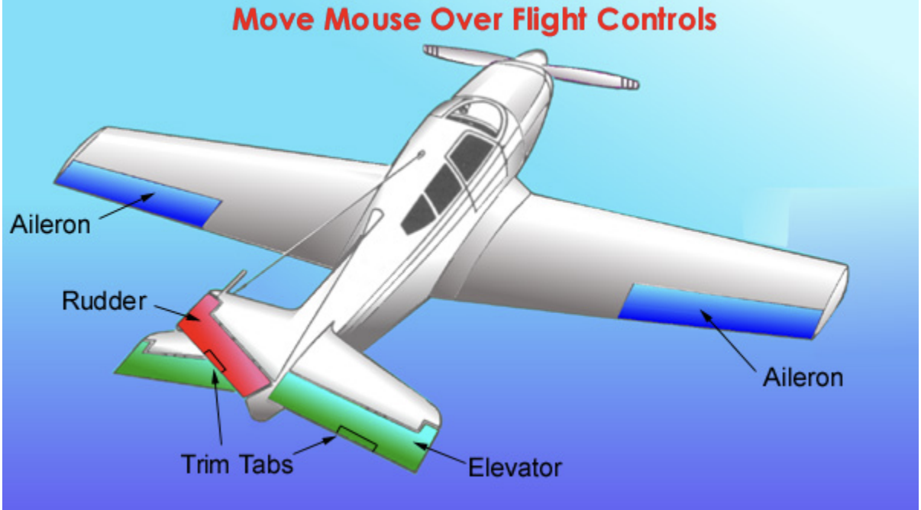
Key Lesson:
Control Surfaces
If you want to change how your plane flies in the air you need to use control surfaces. But do you know how they work?
Control Surfaces:
Aileron: Tilts the plane side to side (roll) by changing lift on the wings.
Elevator: Moves the nose up or down (pitch) by changing tail direction.
Rudder: Turns the nose left or right (yaw) by pushing the tail sideways.

Slide 10
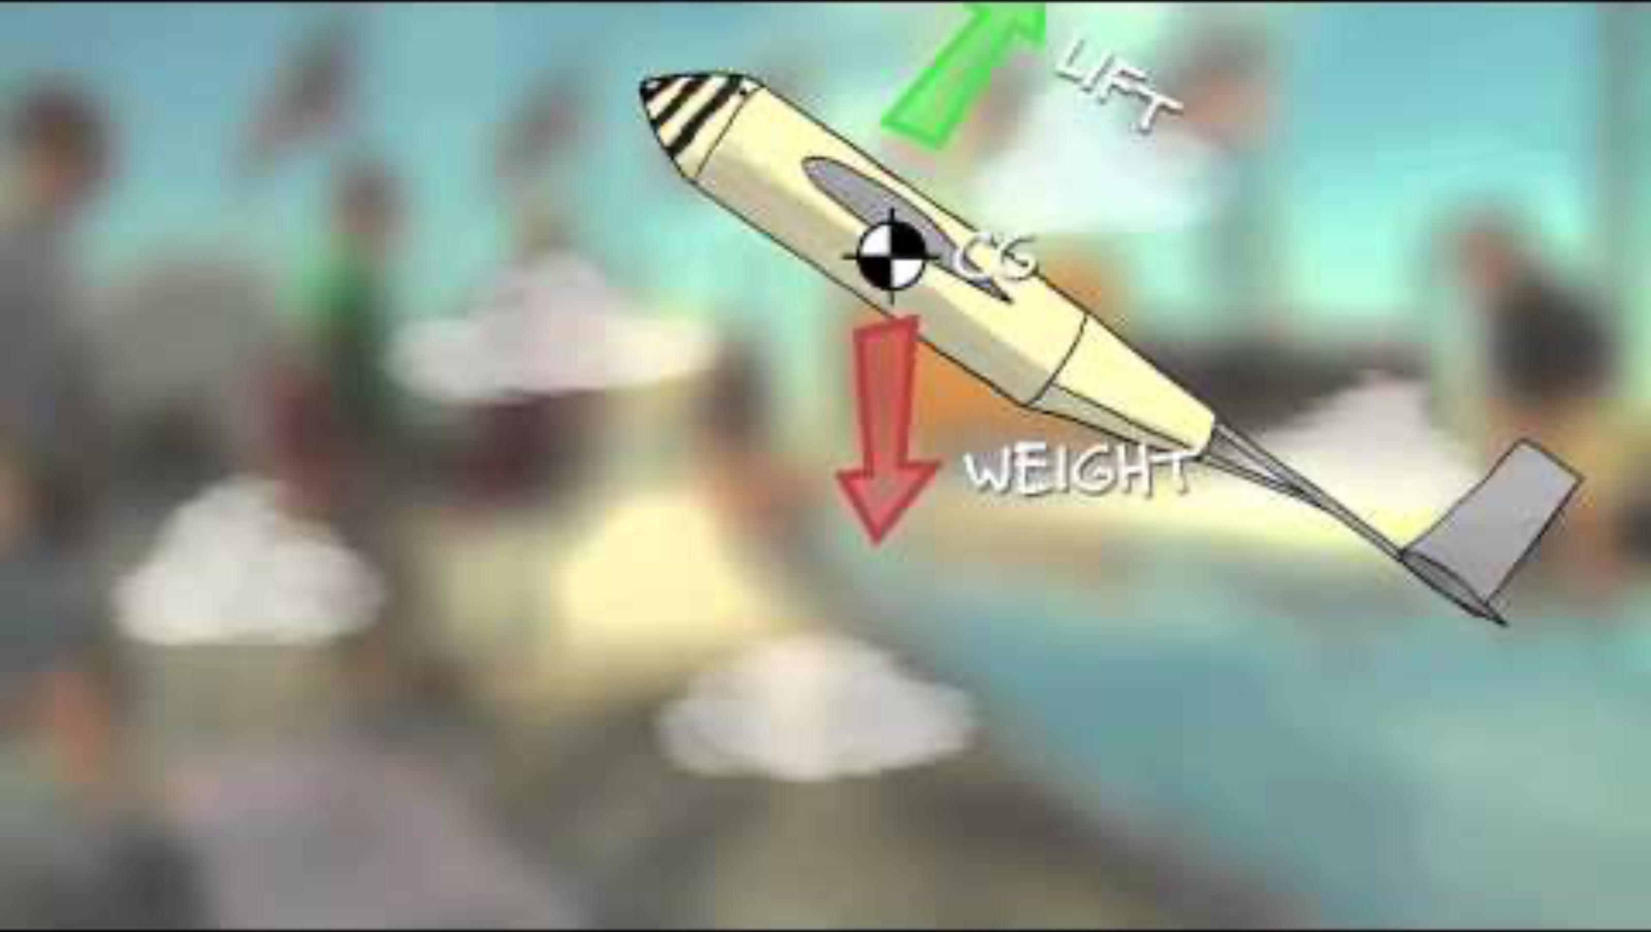
Key Lesson:
Stability
If you want your plane to fly far it has to be stable in the air!
Center of Gravity (CG):
You can change the CG by adding small weights (clay)
Move CG Forward: add clay to the front
Move CG Backward: add clay to the back

